Slide 1

Mary Noodle Doodles Professional Website for Child Content Design and Illustration
Rivera, Angie (VC1C)
Angiervr9@gmail.com; Angie.Rivera81@bcmail.cuny.edu
Supervisor: Marybeth Bulter Rivera
marybeth.b.rivera@gmail.com

Slide 2

Abstract
This project aims to create a professional, user-friendly website for MaryBeth Butler, a talented child content designer and illustrator, to help her reach scouts and potential clients in the children's content design industry. The website will serve as a portfolio platform that highlights MaryBeth's work, making it easily accessible to potential clients and scouts looking for creative content for children. The goal is to build a visually appealing and responsive website that integrates a contact form, SEO optimization, and social media sharing, offering an efficient way for users to inquire about services. The project will focus on the technical aspects of building a robust platform, including web development, form handling, and ensuring a smooth user experience across devices.

Slide 3
TOOLS

Slide 4
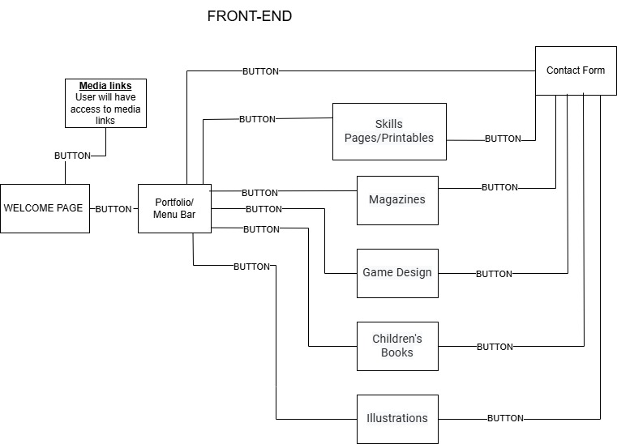
USER FLOW

Slide 5
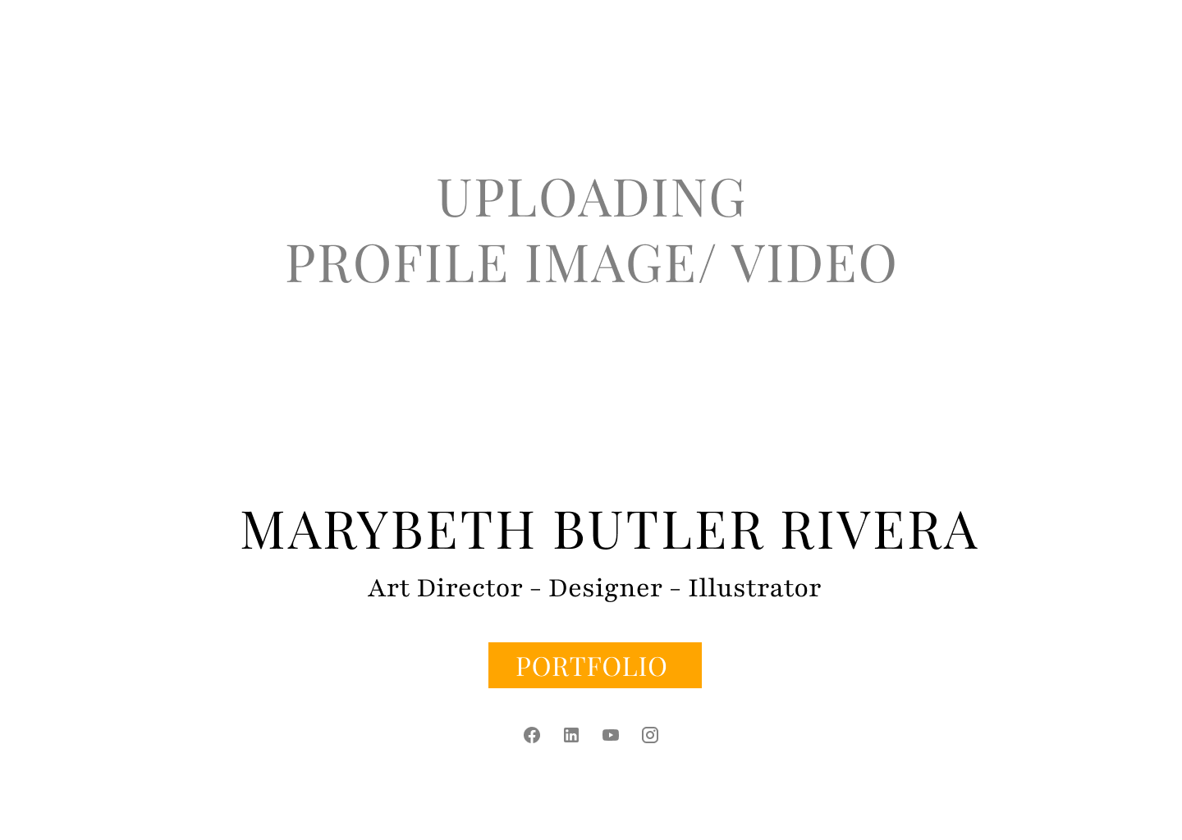
DRAFT 1

Slide 6
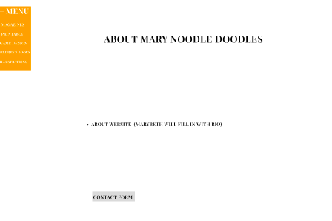
DRAFT 1

Slide 7
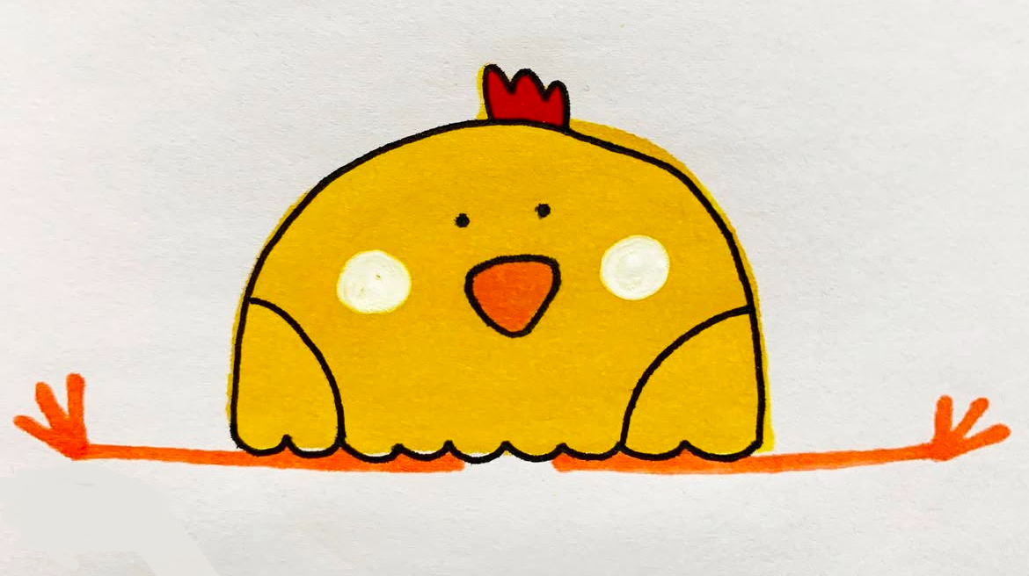
Project Break down
Phase 1:
Use Figma (build a layout)
Get approval and adjust changes as need
Create HTML/CSS
Phase 3:
Backend Integration of contact form
Phase 4:
Social media links
SEO setup
TEST
Phase 2:
Finalize HTML/ CSS
Create a domain name (Hosting)

Slide 8
TENTIVE schedule
WEEK | TASK | DURATION
Week 1 | Finalizing project scope, gathering requirements from MaryBeth, and initial wireframe designs | 1 week
Week 2 | Phase 1-2: Frontend design(HTML, CSS) and layout development (React)/create a domain | 2 weeks
Week 3 | Phase 1-2: Frontend design(HTML, CSS) and layout development (React) /create a domain | 2 weeks
Week 4 | Test Phase 1-2 | 1 week
Week 5 | Prepare demo 1 for supervisor / Record Demo 1 w/ live Presentation | 1 week
Week 6 | Phase 3-4: Backend/Integration of contact form, social media links, and SEO setup | 2 weeks
Week 7 | Phase 3-4: Backend Integration of contact form, social media links, and SEO setup | 2 weeks
Week 8 | Test Phase 3-4 | 1 week
Week 9 | Prepare demo 2 for supervisor / Record Demo 2 w/ live Presentation | 1 week
Week 10 | Final Test / Final Recording | 1 week
Week 11 | Final Presentation Slides | 1 week
Week 12 | Final look over and Submit | 1 week

Slide 9
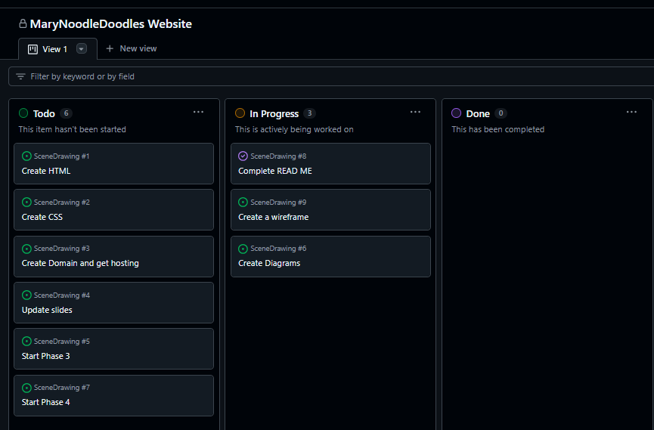
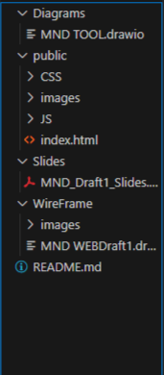
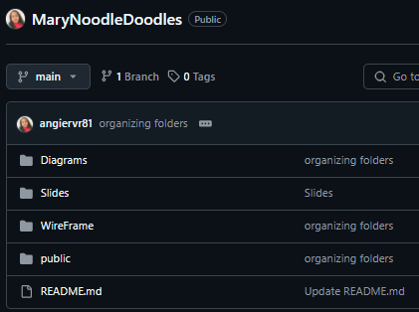
Links to Repository & Management Tools
Repository Link: https://github.com/angiervr81/MaryNoodleDoodles.git
Project Management Link::View 1 · MaryNoodleDoodles Website
Project Mangement
Repository Layout

